Slide 1
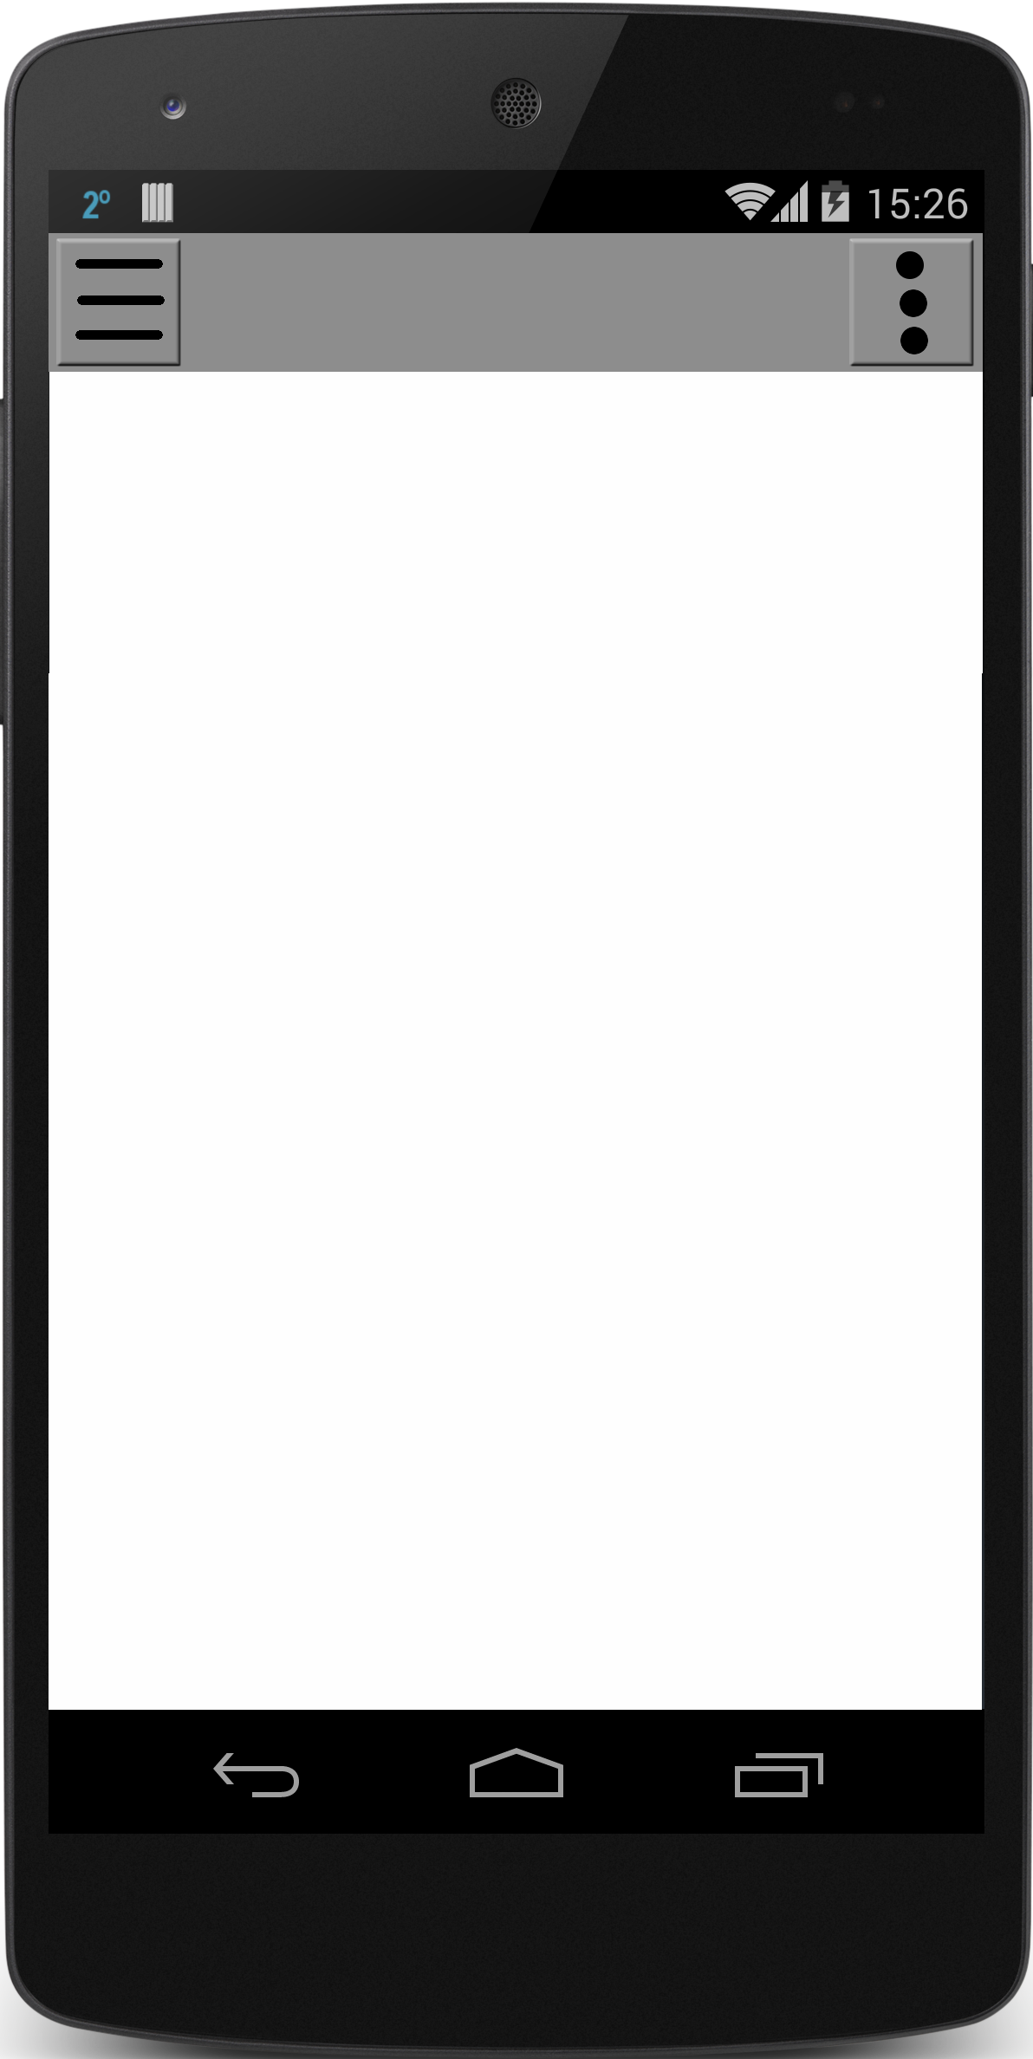
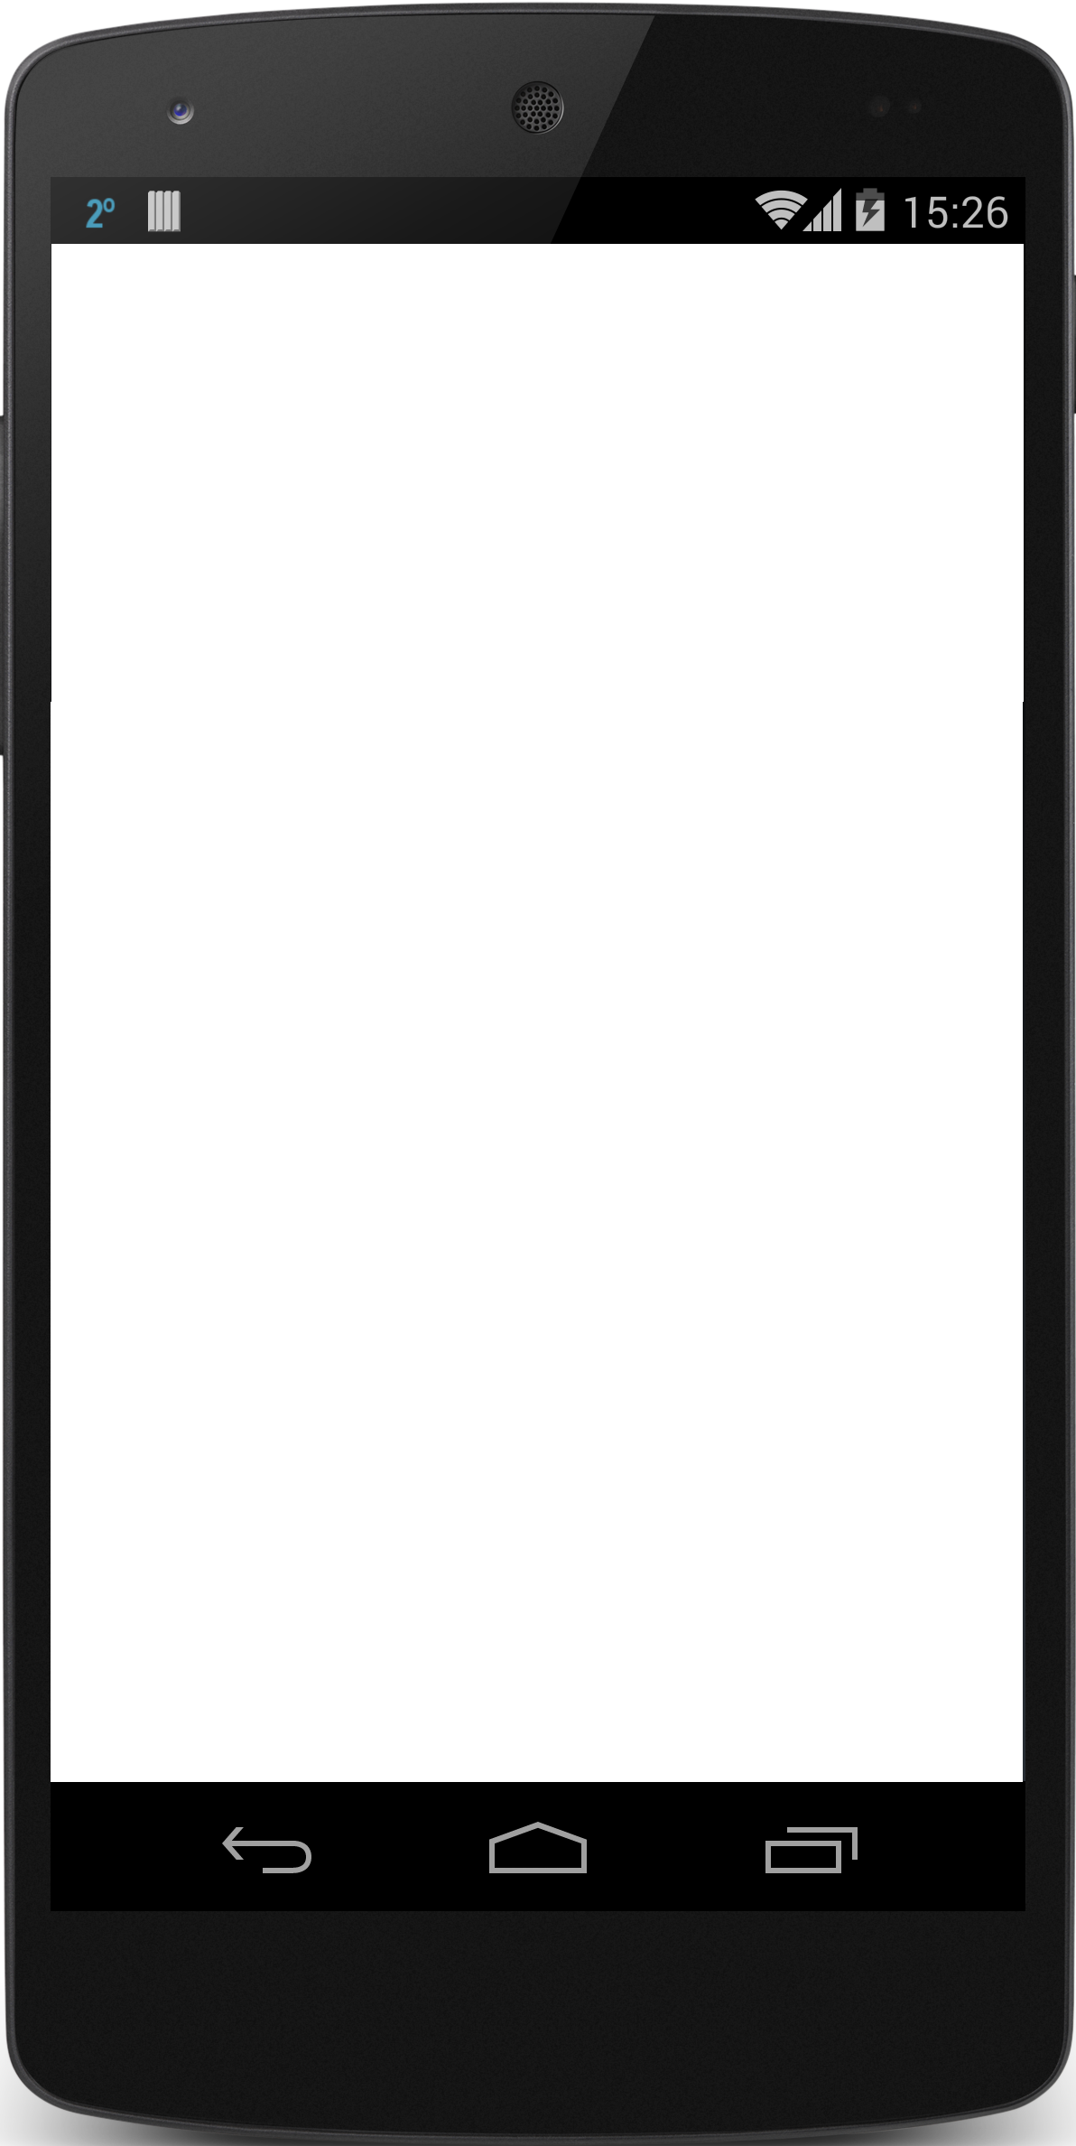

Notes:
TEMPLATES

Slide 2
Login Page
Username
Password
LOGIN
Facebook
Google
Register
Forgot Password

Slide 3
Register Page
Username
First Name
Last Name
Email
Phone Number
Zip-Code
Password
Confirm Password
Accept User Agreement
Register
Cancel
Notes:
Need to check against existing usernames

Slide 4
Reset
Password
Page
Password Reset
*Enter Email Phone Number Or Username
Submit
Cancel
Notes:
Can throw an error under the text field if the user doesn’t exist
Will parse automatically the texts inputted

Slide 5
Change
Password
Page
Password Change
Verification Code
New Password
Confirm Password
Submit
Cancel
Notes:
Can throw an error under the text field if the user doesn’t exist
Will parse automatically the texts inputted

Slide 6




NAV
Menu
Settings
Map
List
Home
Map-View
Add Game
Notes:
Shows a map containing the games in a certain area with an icon to match the description

Slide 7
NAV
Menu
Settings
Map
List
Search
Filter
V
Results: 4
Home
List-View
Basketball Game
South Park (3 miles)
3/6
10:00am – 12:00pm
Tennis
North Park (4 miles)
1/2
3:00pm – 4:30pm
# of players/ total
Big Soccer Game
7/10
East Park (3.75 miles)
6:00pm – 8:00pm
Basketball Game
The Y (2 miles)
4/15
6:00am – 7:00pm
Add Game
Notes:
Shows a map containing the games in a certain area with an icon to match the description

Slide 8
Menu
Misc.
Map
List
Search
Home
Logout
Filter
V
My Profile
Results: 4
Nav Menu
View
Basketball Game
Help
Friends
3/6
South Park (3 miles)
10:00am – 12:00pm
Events
Misc.
View
Tennis
North Park (4 miles)
1/2
3:00pm – 4:30pm
Settings
Messages
Big Soccer Game
7/10
East Park (3.75 miles)
6:00pm – 8:00pm
Achievements
Contact
Basketball Game
The Y (2 miles)
4/15
Discover
6:00am – 7:00pm

Slide 9
Chat: Mike Jones, Random Dude
+
Mike Jones
Hey everyone message
here if you want in.
Random Dude
Chat View
I am so down. Do we need to bring anything
Mike Jones
If you could bring a black and
White shirt that would be
great.
Random Dude
Ok will do!
Message here
>
Notes:
Grant

Slide 10



Game Title
Captain: Mike Jones
Location: North Park
Time: 12:00pm – whenever
Pop up (“joined”)
Button changes to
”Leave Game”
Players: 3/6
Game
View
Description:
We want to get a game of 3 on 3 together
around noon. Any skill level is welcome.
JOIN GAME
3 Players
Mike Jones
1
10
Random Dude
1
10
Group Message
Notes:
Add list of items to bring button (checklist of game items)
We will need an edit view for this screen as well
The lighning bolt could be the message indicator

Slide 11

SuperBaller76
SuperBaller76
Age: 17
Age: 17
Edit
Zip: 50266
Zip: 50266
Edit
10
Gender: Male
Gender: Male
Edit
1
Last Active:
01/20/2016
Friend
View
Games: 3
Bio:
I like basketball, football, baseball, and magic the gathering.
User/Admin
View
Add Friend
Message Me
Edit
Achievements
Notes:
Add Last Games Played in as well

